Slide 1
Unsupervised Learning with NLP to Extract Similarities between Terms of Services
Lessons Learned
Andrew Haverly

Slide 2
Struggles
Relatively unique problem (I haven’t read much about this)
Didn’t have a clear process for solving the problem in my head
Plan #1: Clustering for all data
Plan #2: Distance measures for known ToS

Slide 3
Detailed Implementations (Clustering)
Gather a lot of ToS (final result was 105 unique ToS)
Perform unsupervised clustering with an ideal number of clusters
How to find this ideal number of clusters?
Use clustering indices to indicate which number of clusters was ideal
Use the trained clusters to determine which known ToS is most similar to a novel ToS

Slide 4
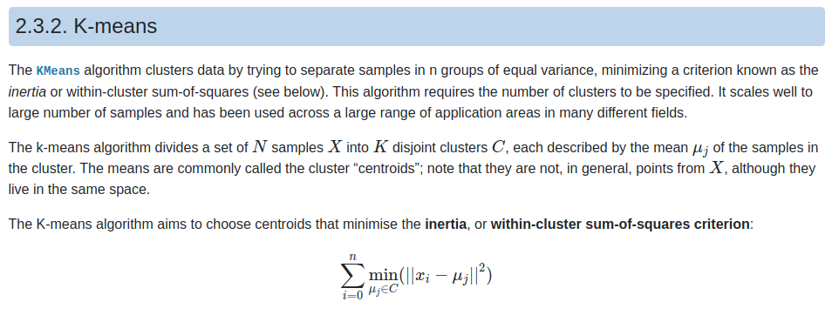
Mathematical Understanding (Clustering)
K-means - divides a set of N samples into K (hyperparameter) disjoint clusters, each described by the average vector of the samples in the cluster. Minimizes the within-cluster sum-of-squares
https://scikit-learn.org/stable/modules/clustering.html#k-means

Slide 5
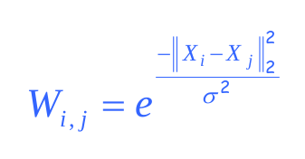
Mathematical Understanding (Clustering)
Spectral Clustering - performs a low-dimension embedding of the affinity matrix between samples, followed by another clustering algorithm (K-Means)
Affinity matrix formulation:
https://www.google.com/url?sa=t&rct=j&q=&esrc=s&source=web&cd=&ved=2ahUKEwiB9r3a3N_vAhWWQjABHd11AFcQFjACegQIAxAD&url=https%3A%2F%2Fwww.cs.cmu.edu%2F~epxing%2FClass%2F10701-08s%2FLecture%2Flecture23-Spectral.pdf&usg=AOvVaw06QejPAqYUlAxAes6SVFlt
https://scikit-learn.org/stable/modules/clustering.html#spectral-clustering

Slide 6
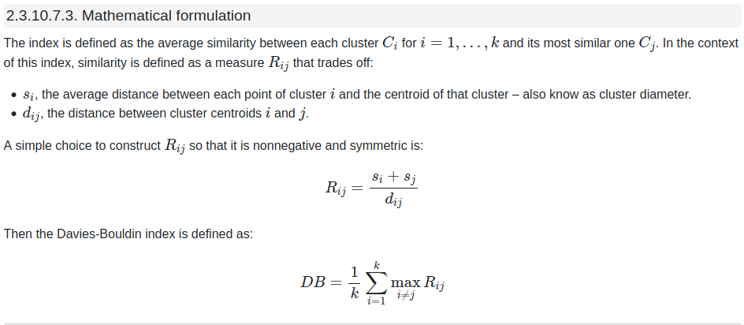
Mathematical Understanding (Clustering)
Davies-Bouldin Index - signifies average ‘similarity’ between clusters. The similarity is based on comparing the distance between clusters with the size of the clusters themselves. Zero is the best score.
https://scikit-learn.org/stable/modules/clustering.html#davies-bouldin-index

Slide 7
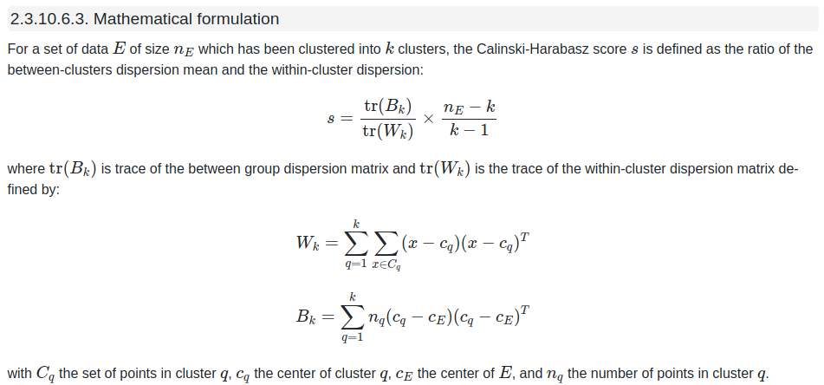
Mathematical Understanding (Clustering)
Calinski-Harabasz Index - ratio of the sum of between-clusters dispersion and within-cluster dispersion. Score is higher when well separated.
https://scikit-learn.org/stable/modules/clustering.html#calinski-harabasz-index

Slide 8
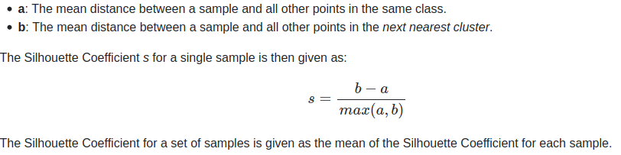
Mathematical Understanding (Clustering)
Silhouette Coefficient - compares the density of a cluster with the proximity of the next nearest cluster. +1 is the best score, -1 is the worst score.
https://scikit-learn.org/stable/modules/clustering.html#silhouette-coefficient

Slide 9
Detailed Implementation (Similarities)
Focused around the problem
Collect a lot of ToS. Use these to define the normal frequency of words in a ToS
Find the known ToS and the new ToS
Create the vectors (just TF-IDF for now)
Use similarity measures to determine which known ToS is most similar to the new ToS
In progress: using clustering algorithms to find which known ToS is most similar to the new ToS

Slide 10
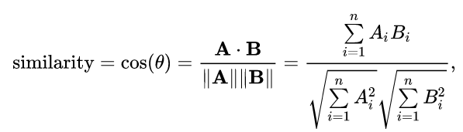
Mathematical Understanding (Similarities)
Using most of the same unsupervised clustering clustering algorithms and similarity indices:
K-Means
Spectral Clustering
Davies-Bouldin Index
Calinski-Harabasz Index
Silhouette Coefficient
New:
Cosine Similarity
https://en.wikipedia.org/wiki/Cosine_similarity

